Slide 1





AI TRIAD ! An AI trip advisor
Project Guide:
Revathy A S
Assistant Professor In CSE
College of Engineering Kidangoor
Submitted by: Group 1 (S8 CSE)
Amrutha Anil(KGR19CS016)
Anandhu Anil(KGR19CS017)
Niveditha R Naik(KGR19CS058)
Sarath Kumar M B(KGR19CS066)
College of Engineering Kidangoor

Slide 2

ABSTRACT
Before the AI revolution, traveling was a chore.
An AI travel assistant , which offers a budget friendly tour packages.
With the help of data science and machine learning, travelers can get recommendations tailored to their needs.
Travelers can use these chatbots more frequently ;
these chatbots can offer answers to frequently asked questions through automated responses.
Aim of the project is to build a virtual travel agent which provide the customers with all sort of service needed during the travel from starting to end

Slide 3


INDEX
1.Introduction
2.Existing System
3.Proposed System
4.Literature Review
5.System Architecture Diagrams
6.Diagrams
7.Software Requirements
8.Hardware Requirements
9.Modules
10.Functionalities
11.Implementation
12.Results
13.Screenshots
14.Publications
15.References
GROUP -1

Slide 4
INTRODUCTION
Travelling is a crucial to think about terms of development. Exchange of traditions, knowledge and fashion helped in opening doors of curiosity for citizenry.
AI now infiltrates every aspect of the tour and travel industry.
AI is playing a really much important role within the tourism industry, globally. From the hotel, flights, visa arrangements, till the booking of the taxi or table within the hotel, we get to ascertain n numbers of applications, websites and portals for an equivalent.
With the assistance of this technology, you’ll get a customized and intelligent travel solution tailored consistent with your needs.
Quick access to the appointments, schedules and reservations with virtual tour planner/ guide making your holiday/tour more stress free.

Slide 5


EXISTING SYSTEM
• Users have to visit a tour planner/ agent to plan or manage all the bookings, accommodations and budget.
• Manual based system where the user needs to work according to the agent plan.
• Systems are strictly time oriented.

Slide 6
PROPOSED SYSTEM
Artificial intelligence can provide a wealth of knowledge on a variety of topics, including general infrastructure, tourist infrastructure, and so on.
Artificial Intelligence (AI) easily addresses customer needs by offering timely information
Artificial intelligence has infiltrated every part of the travel industry.
Reminders and alerts for schedules and appointments come in handy during runtime
You can get a customized and intelligent travel solution tailored to your needs with the aid of this technology.

Slide 7
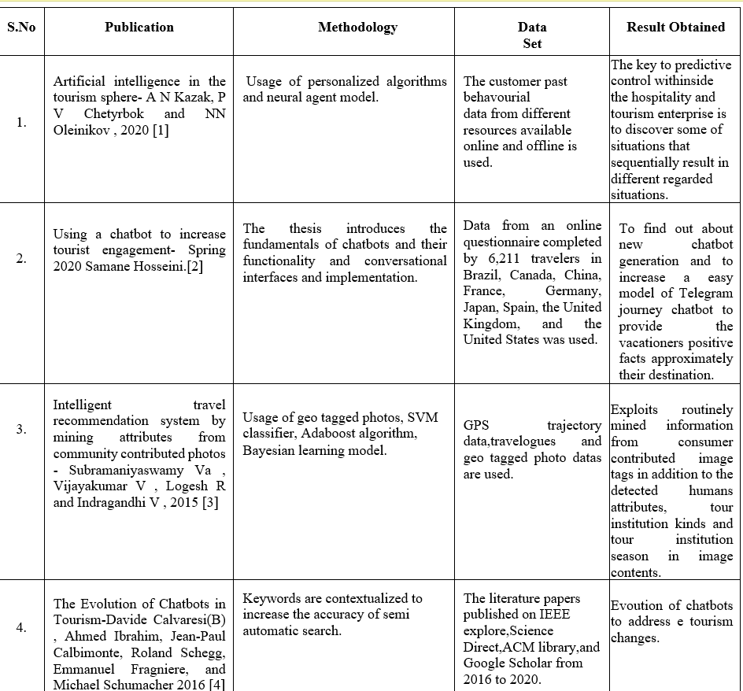
LITERATURE REVIEW

Slide 8
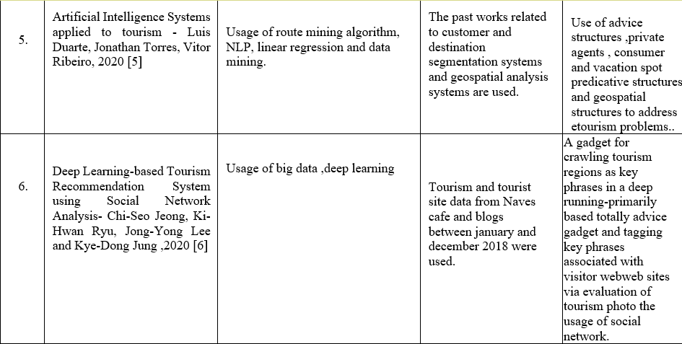
LITERATURE REVIEW

Slide 9
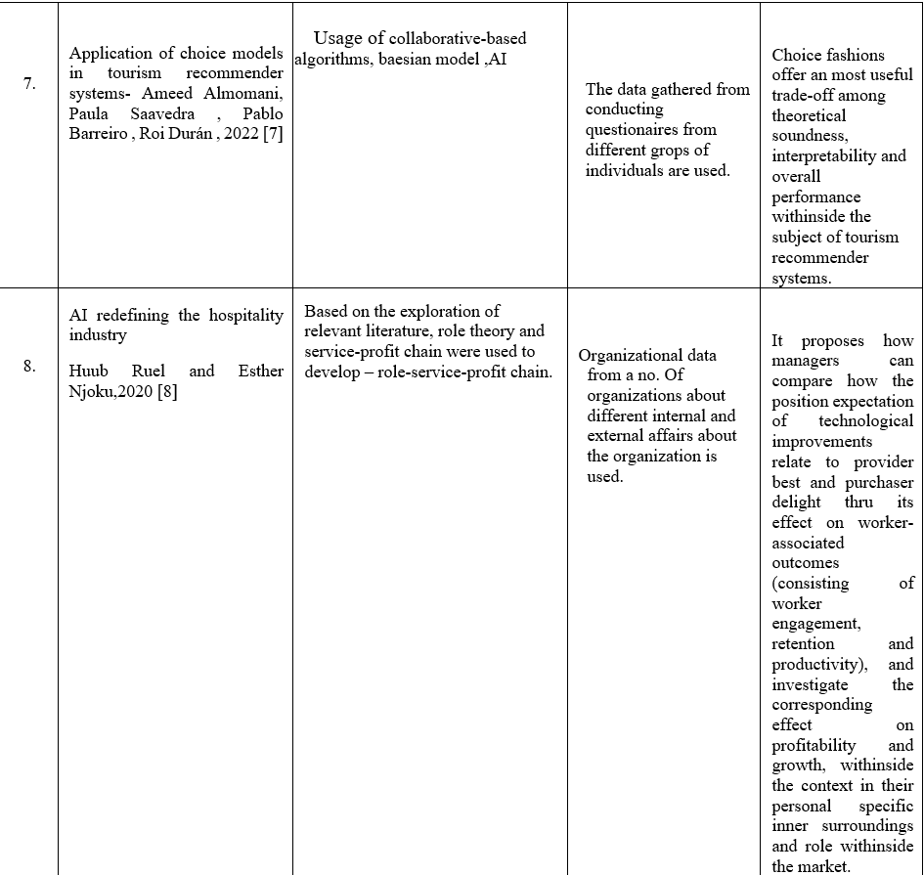
LITERATURE REVIEW

Slide 10
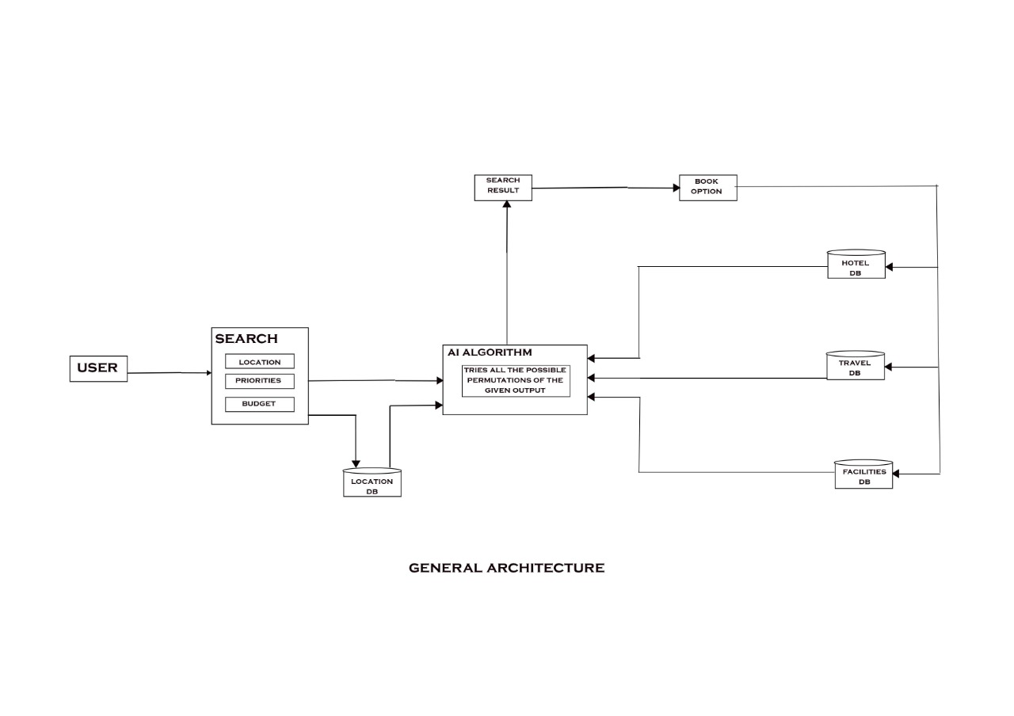
ARCHITECTURE

Slide 11
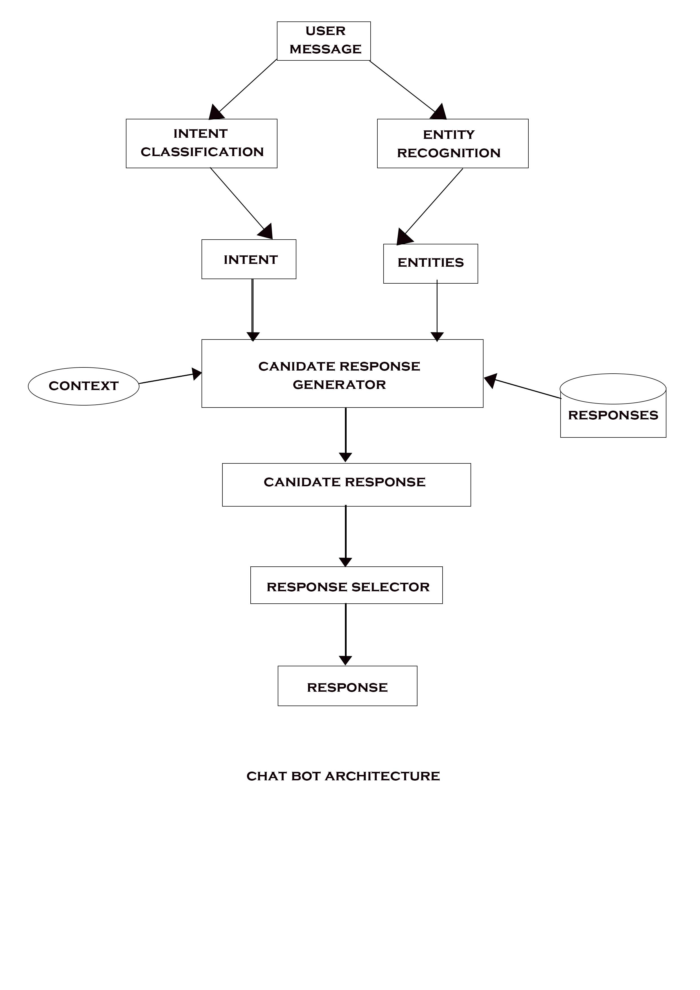
ARCHITECTURE

Slide 12
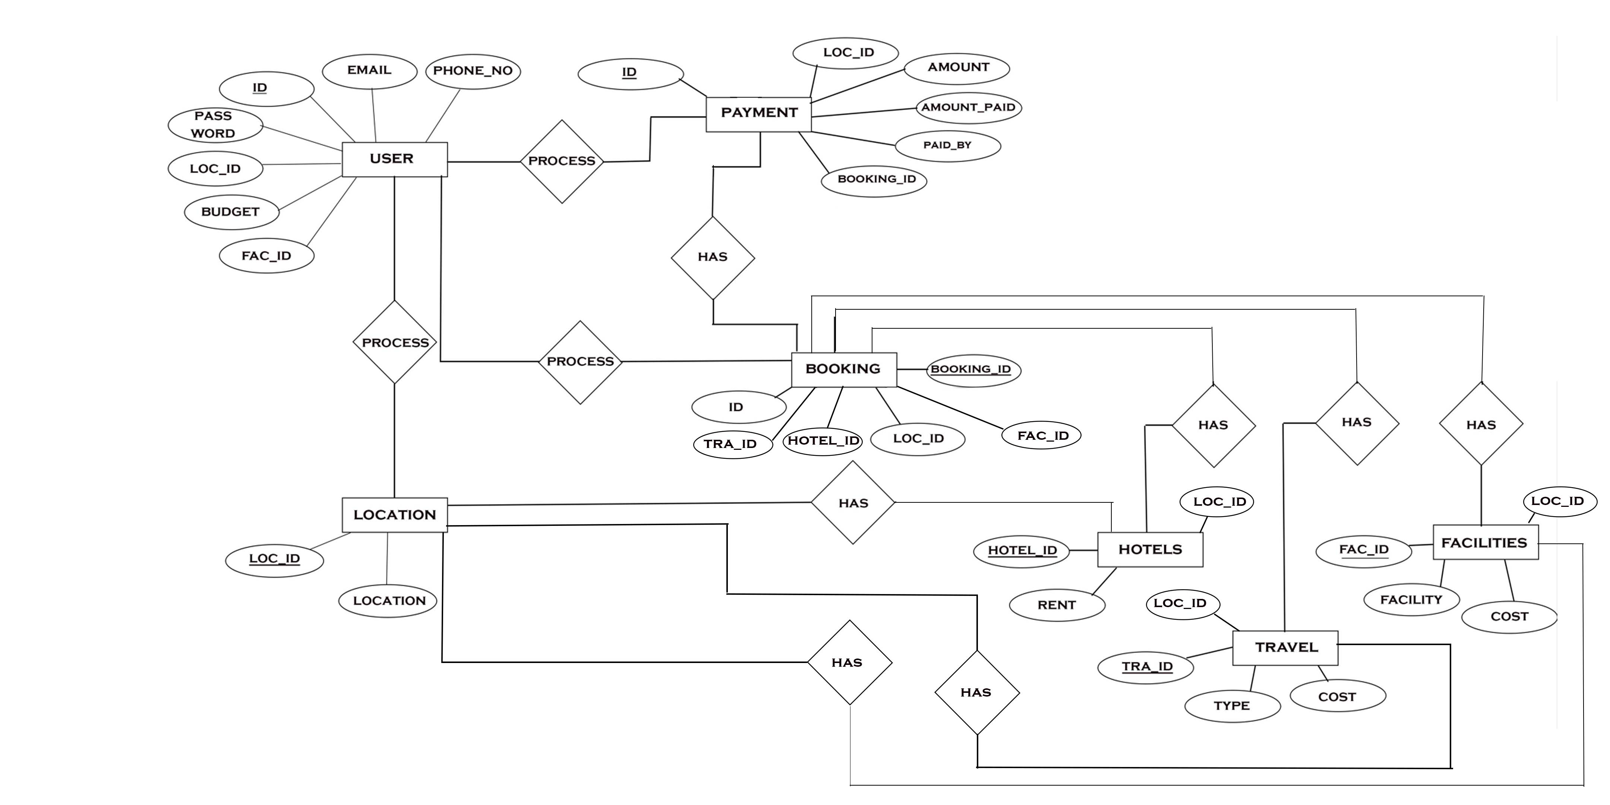
METHODOLOGY: ER DIAGRAM

Slide 13
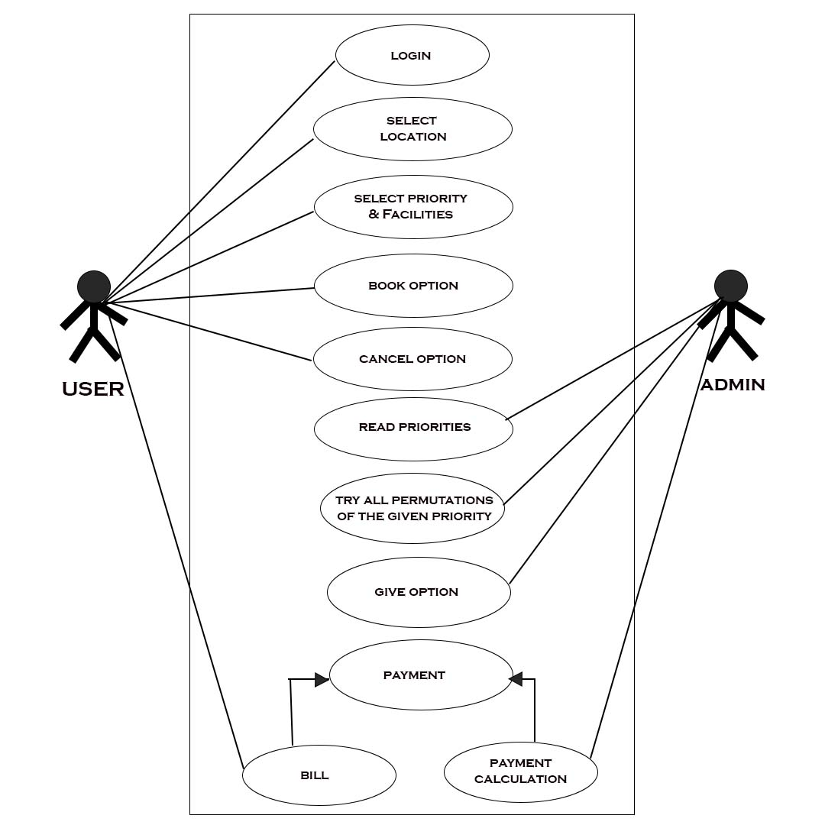
METHODOLOGY: USECASE DIAGRAM

Slide 14
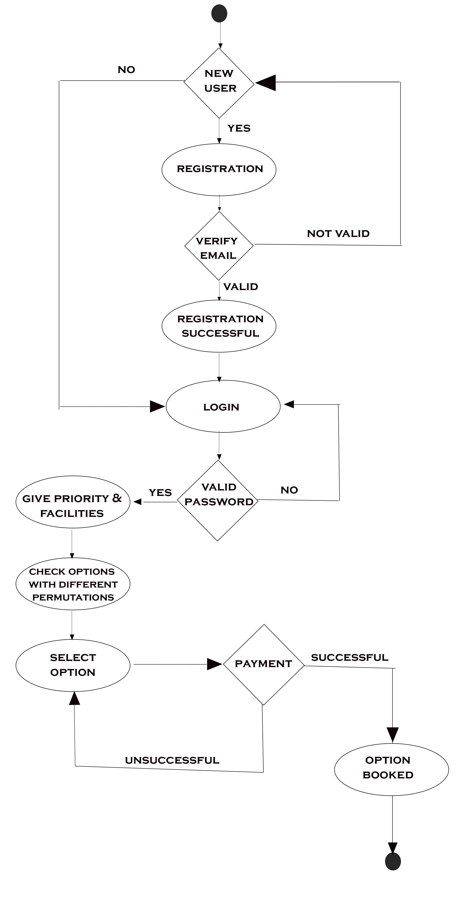
METHODOLOGY:ACTIVITY DIAGRAM

Slide 15
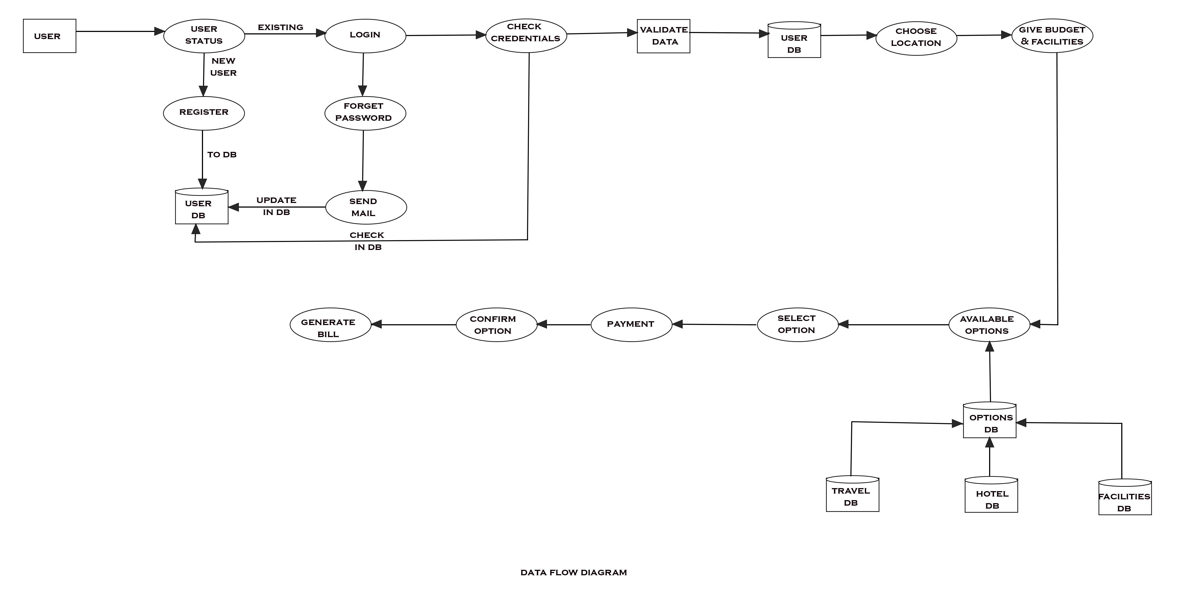
METHODOLOGY:DATA FLOW DIAGRAM

Slide 16
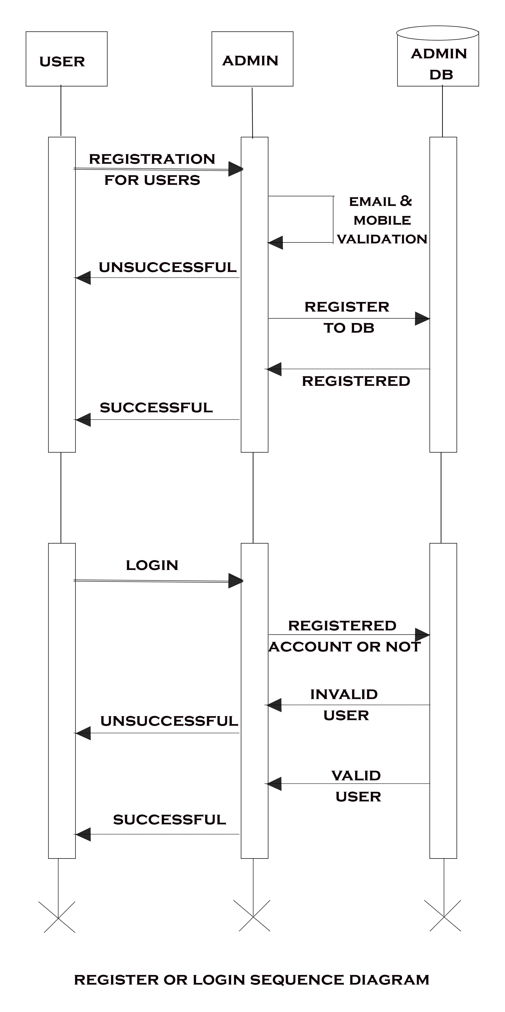
METHODOLOGY:SEQUENCE DIAGRAM

Slide 17
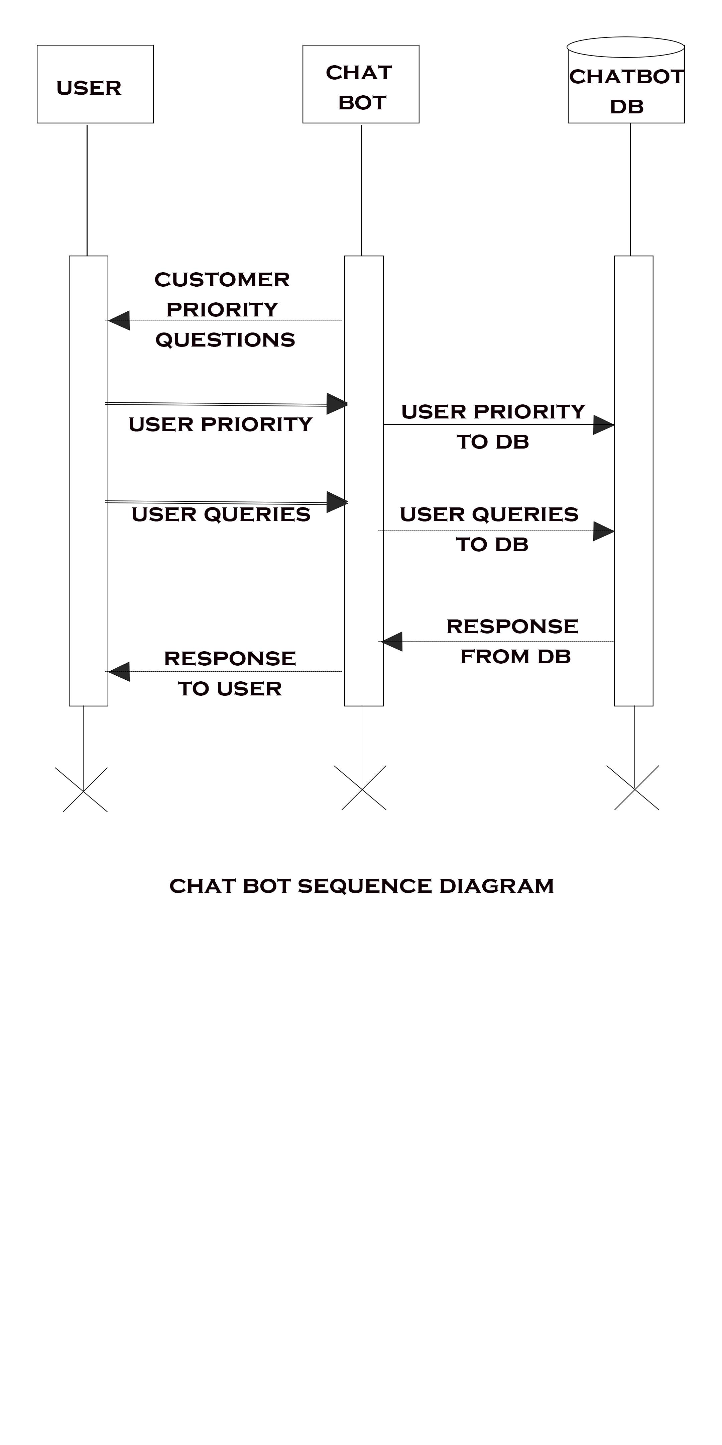
METHODOLOGY :SEQUENCE DIAGRAM

Slide 18
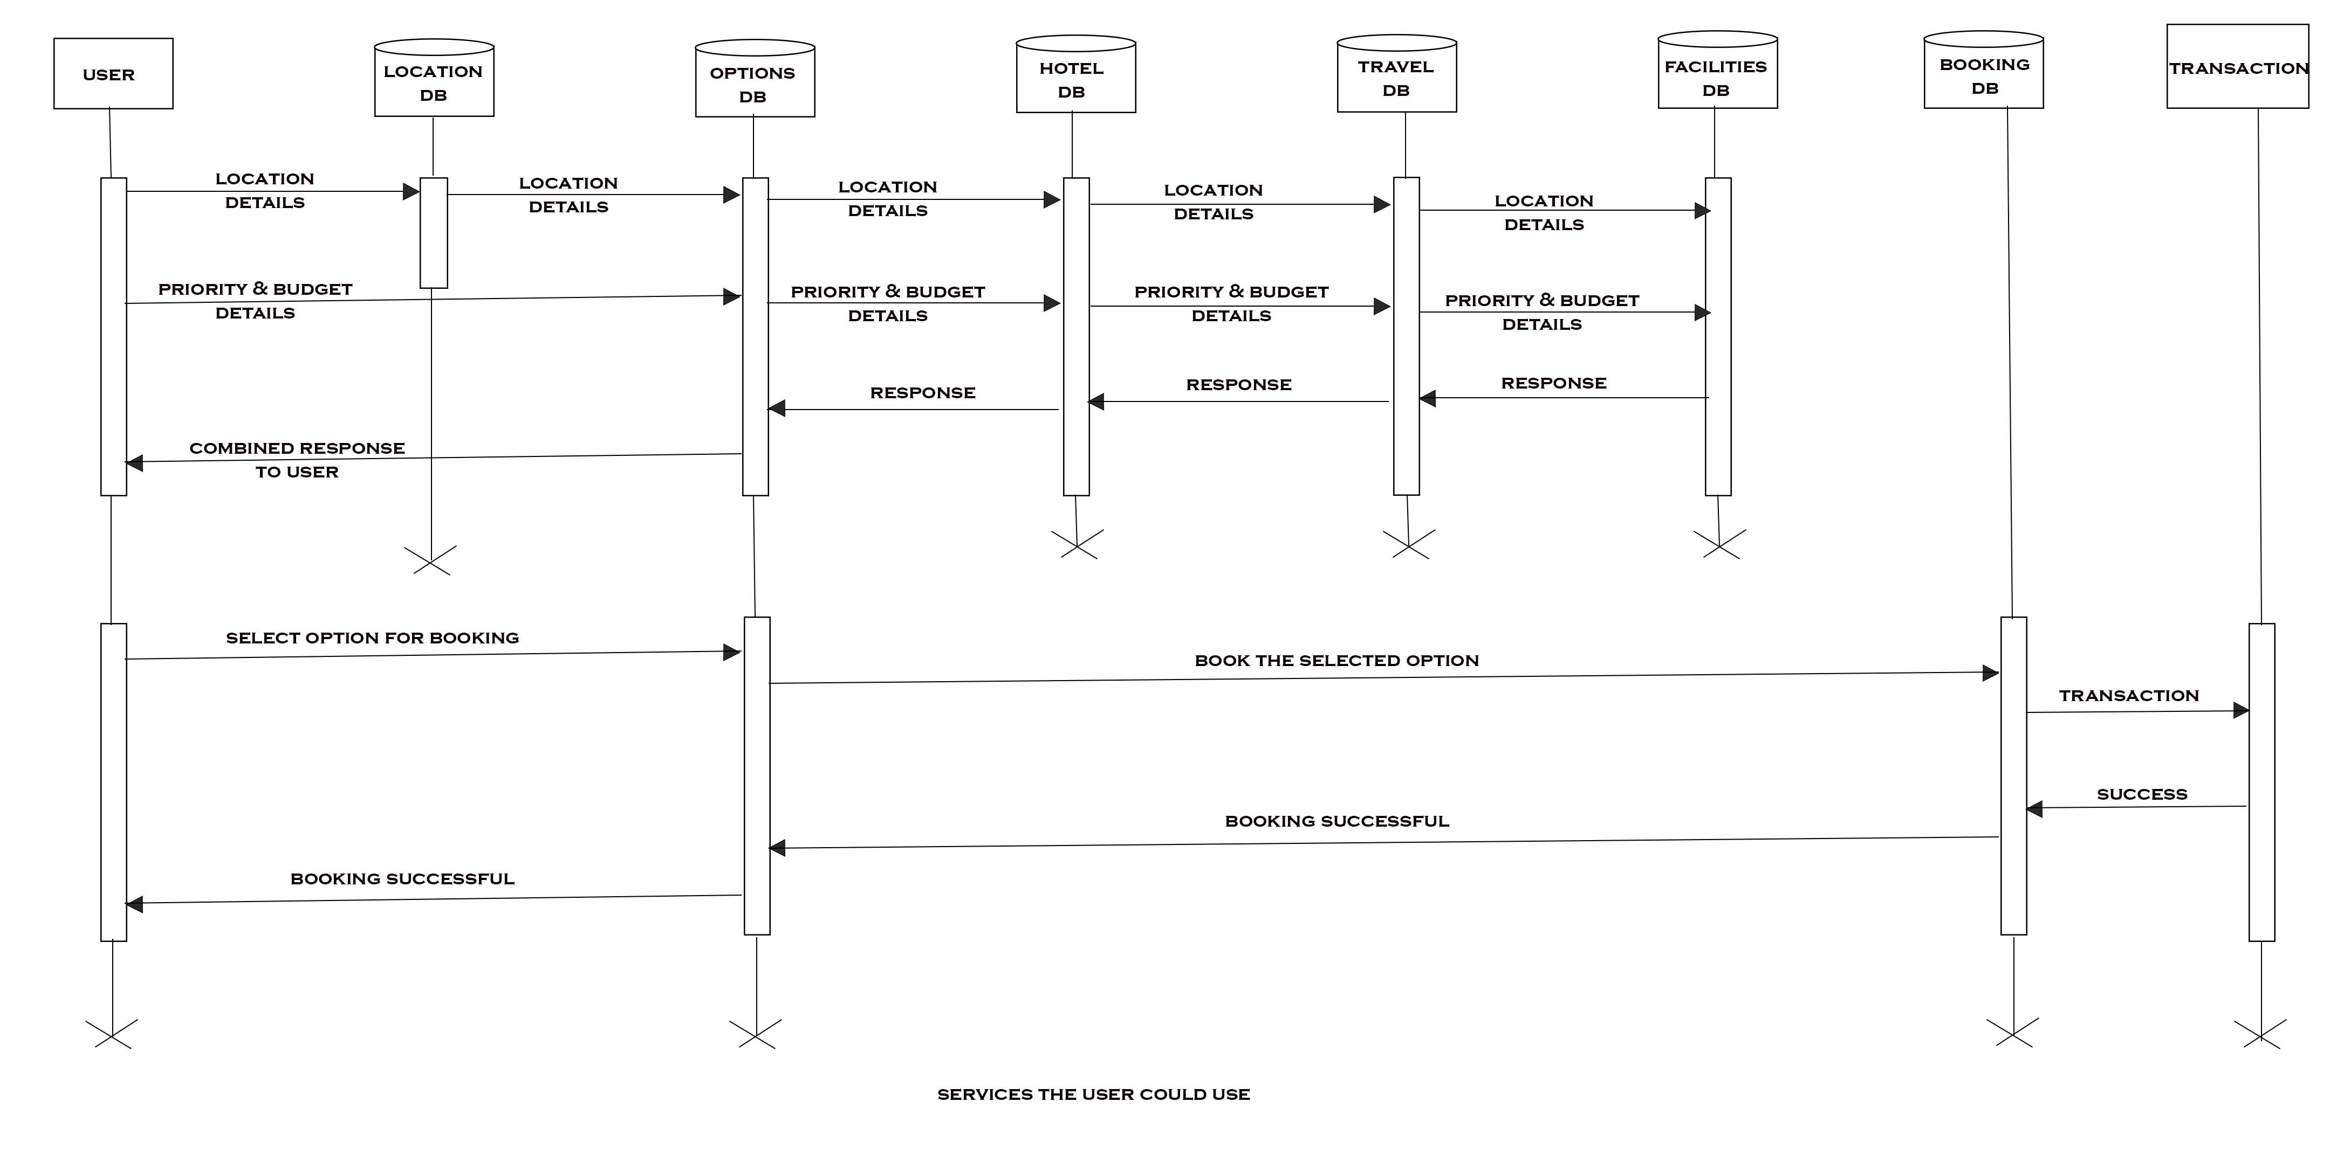
METHODOLOGY:SEQUENCE DIAGRAM

Slide 19
SOFTWARE REQUIREMENTS
Operating System : Windows 10 or above
Database : Firebase
Languages : Flutter,Dart

Slide 20
HARDWARE REQUIREMENTS
Input Devices : Mobile Phone
Memory : 4 GB RAM

Slide 21
MODULES
App User - This is a module used to take information from user . It is used to write the informations to the database.
Hotel – This module gives a detail view of how the hotels are created and how it can retrieved from the users. Overall, this code defines a data model for a hotel with the ability to convert the data to and from a Map representation.
Travel Mode – This module specifies the various initialisations of data related to travel modes such as type, name , rate etc. Similar to the Hotel Data class, this code defines a data model for a travel mode with the ability to convert the data to and from a Map representation.
Trip – This is the module where the chat bot works. The chatbots make a live chat where users can specify their requirements and plan their trip.

Slide 22
FUNCTIONALITIES
REGISTER/SIGN UP
*LOGIN
*SEARCH HOTEL
*SEARCH TRAVEL FACILITY
*SEARCH FACILITIES
*SELECT OPTION HAVING HOTELS,TRAVEL FACILITY AND OTHER FACILITIES
*BOOK OPTION
*TRANSACTION

Slide 23
RESULT
Tourism is currently recognized as a global industry which is highly growing at a high rate like other industries.
Our ‘AI Based Tour Management System’ web based application helps in managing and planning a vacation or a tour with a user friendly environment
Work with runtime changes and schedule the same for necessary requirements
The proposed system also enables users a vacation that can be without any time bound restrictions and best fit in budget.

Slide 24
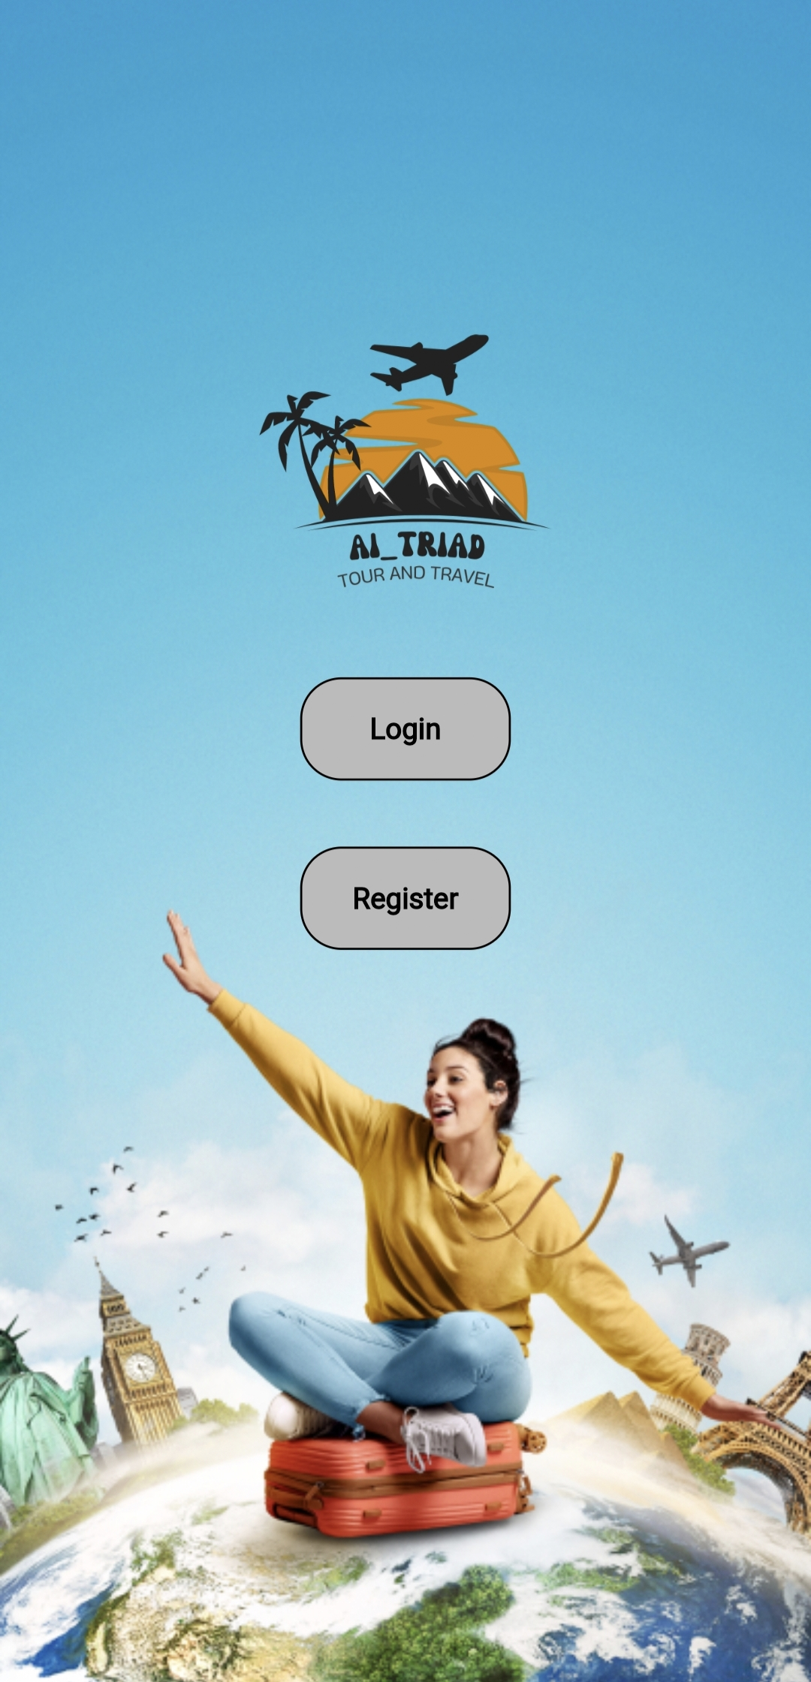
SCREENSHOTS

Slide 25
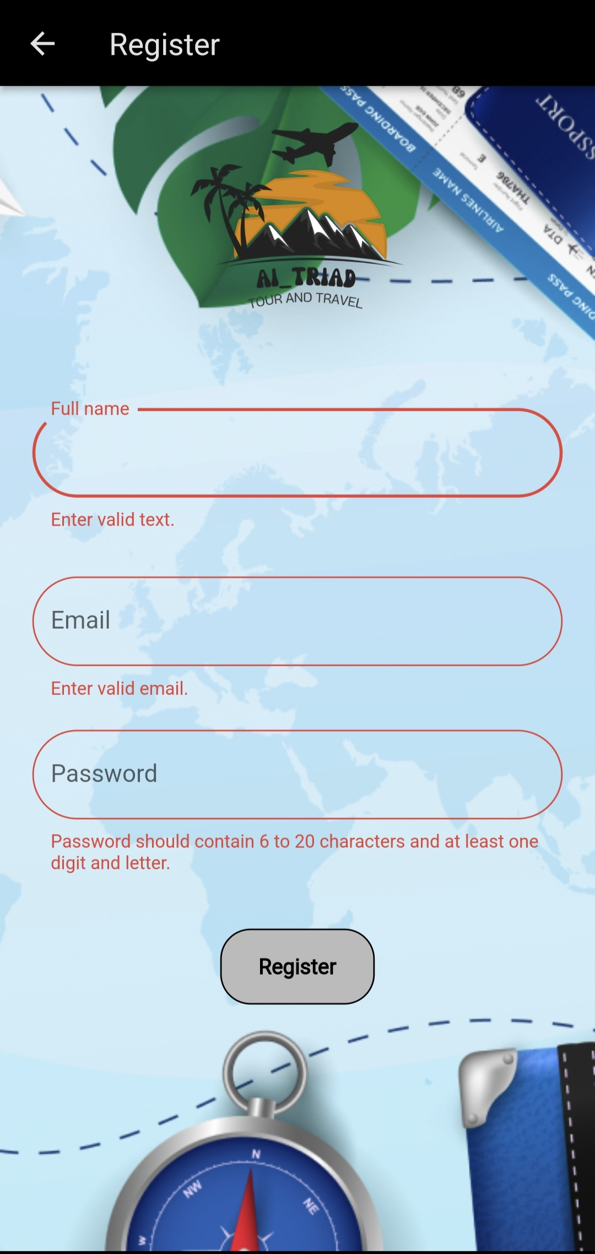

Slide 26
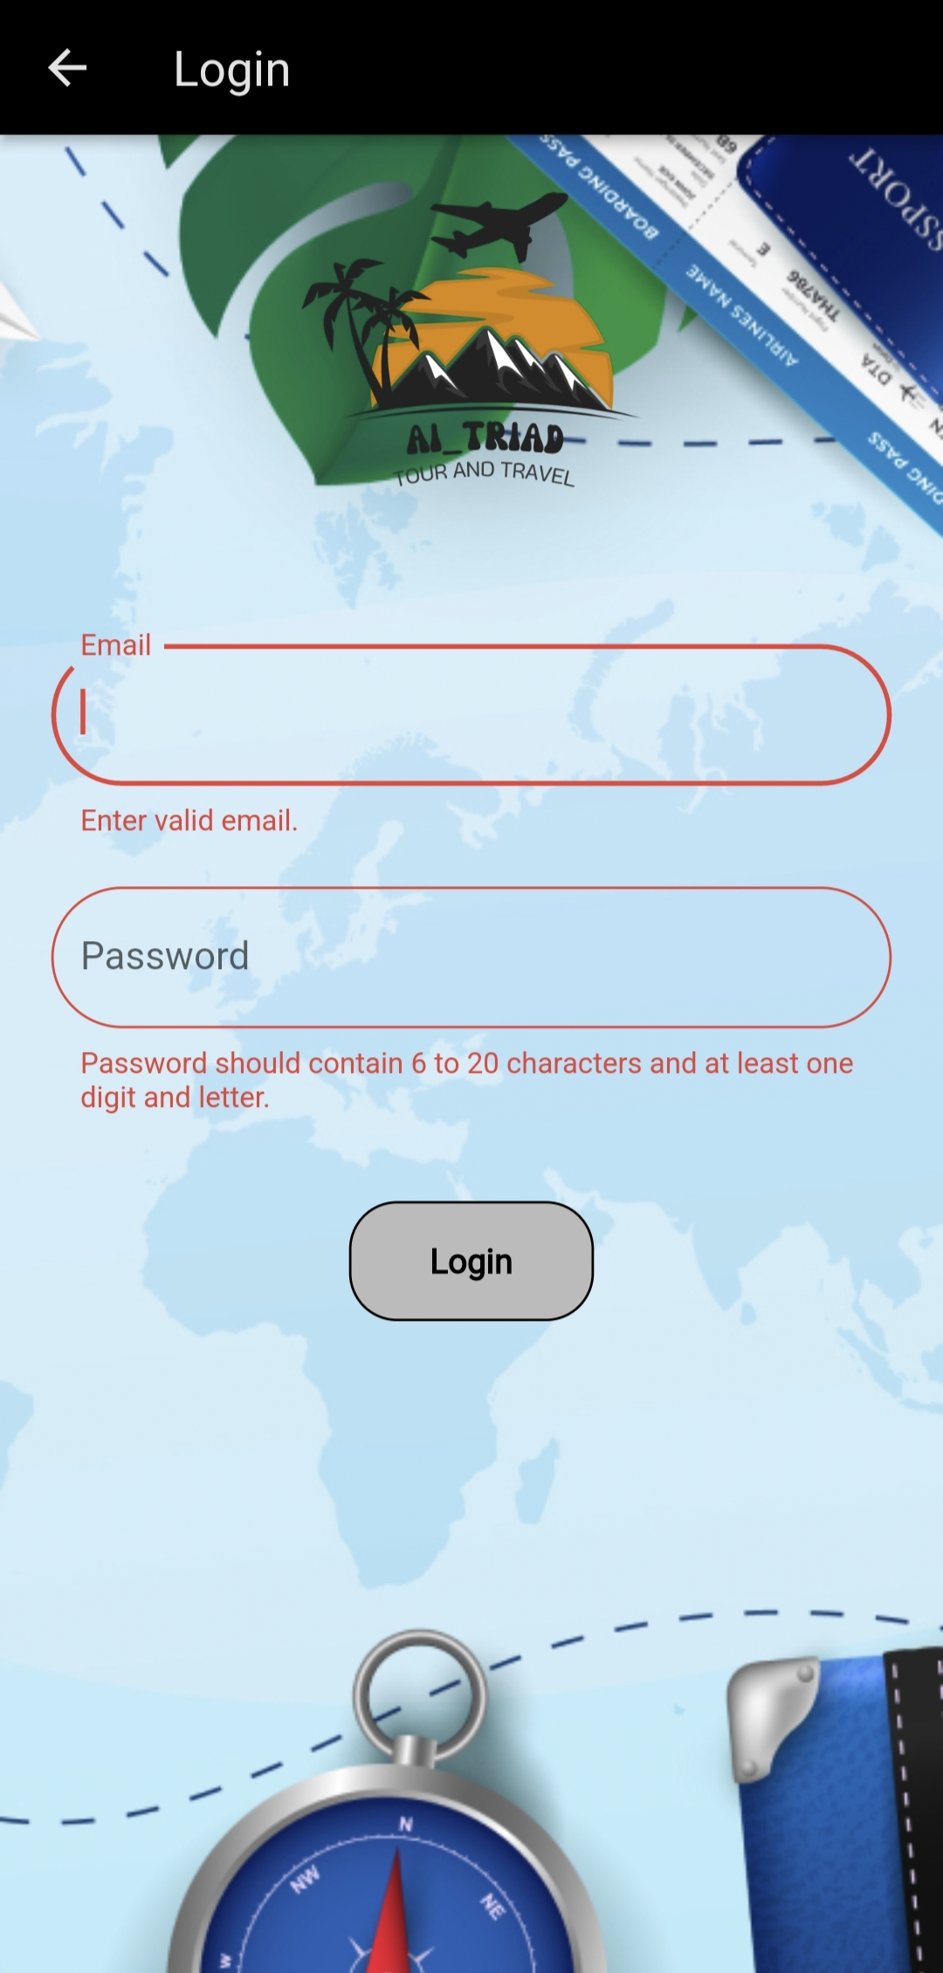

Slide 27
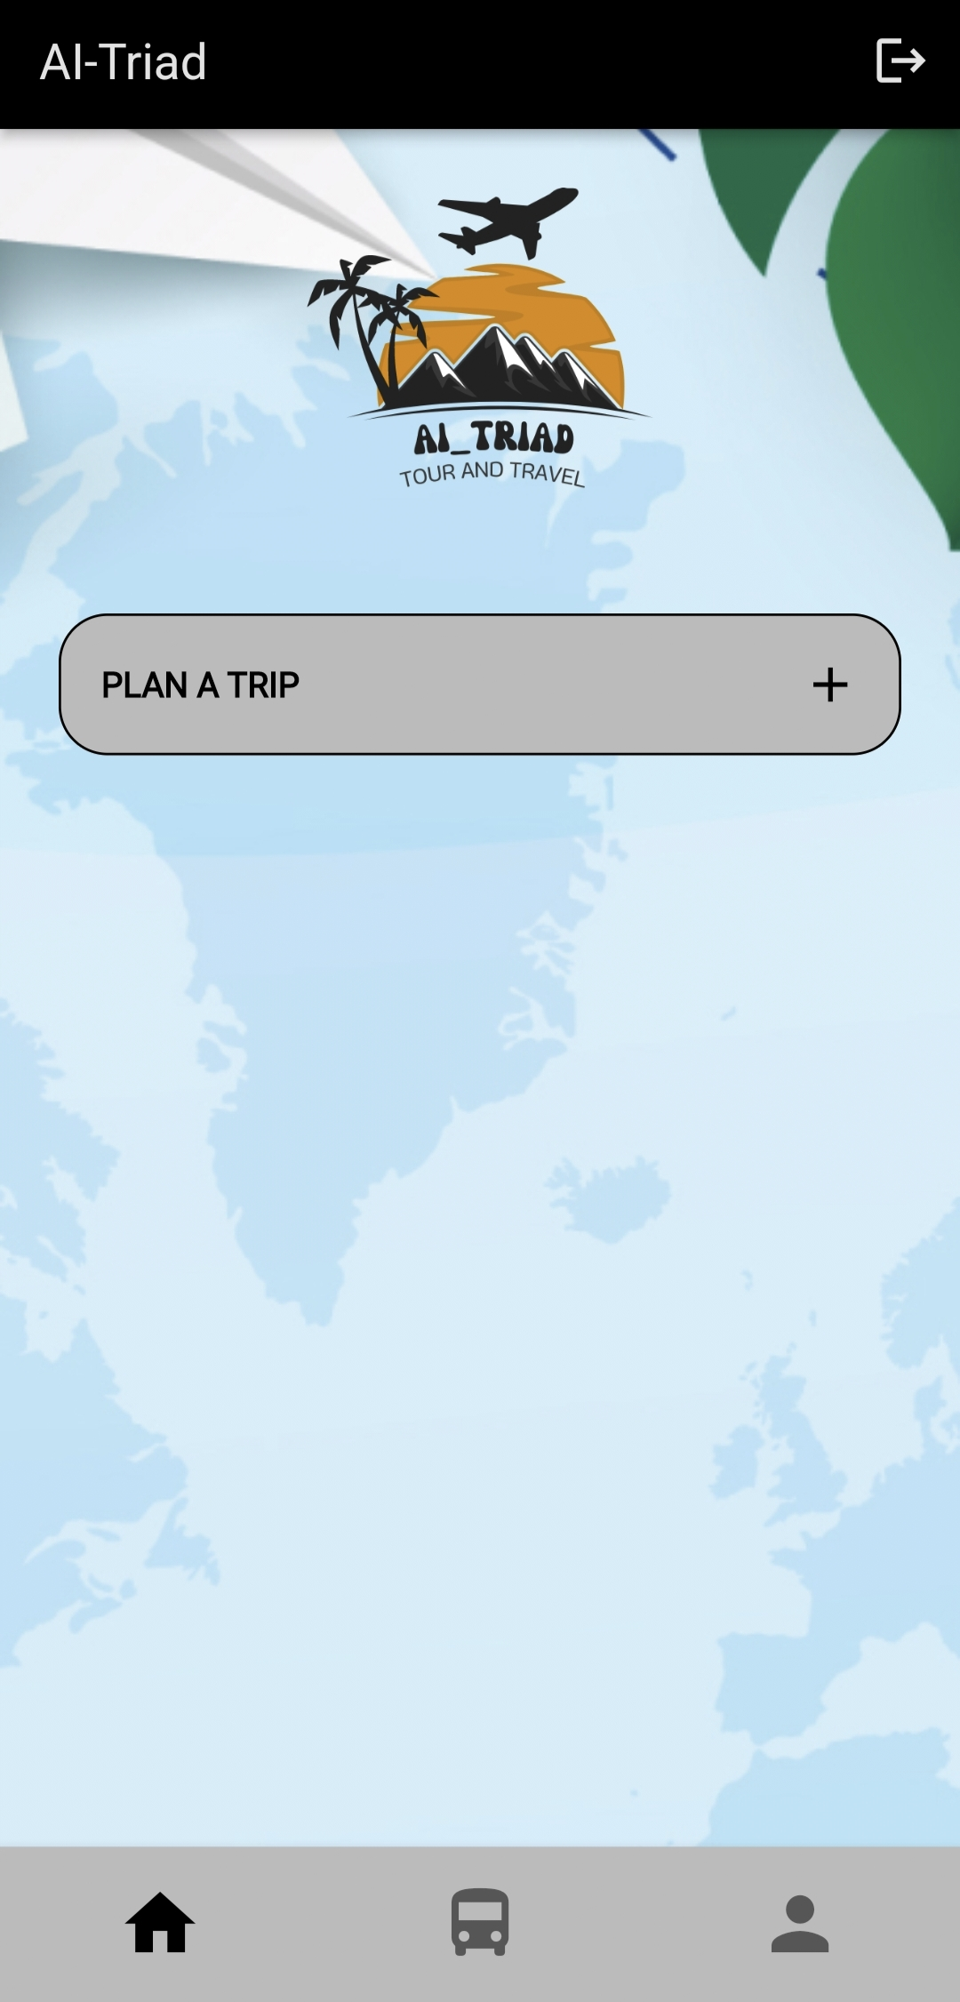

Slide 28
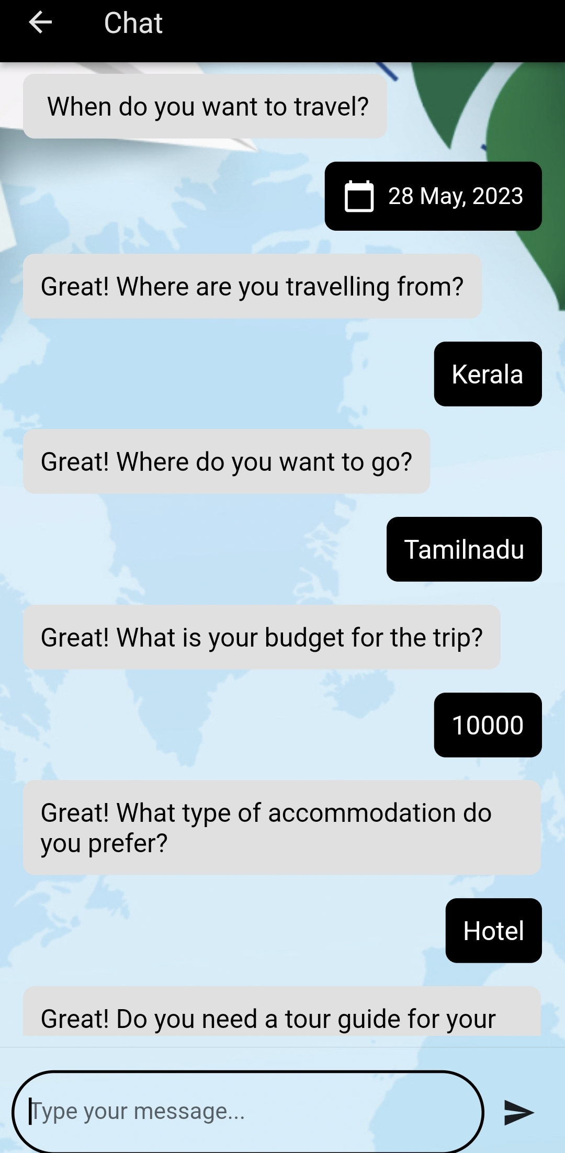

Slide 29
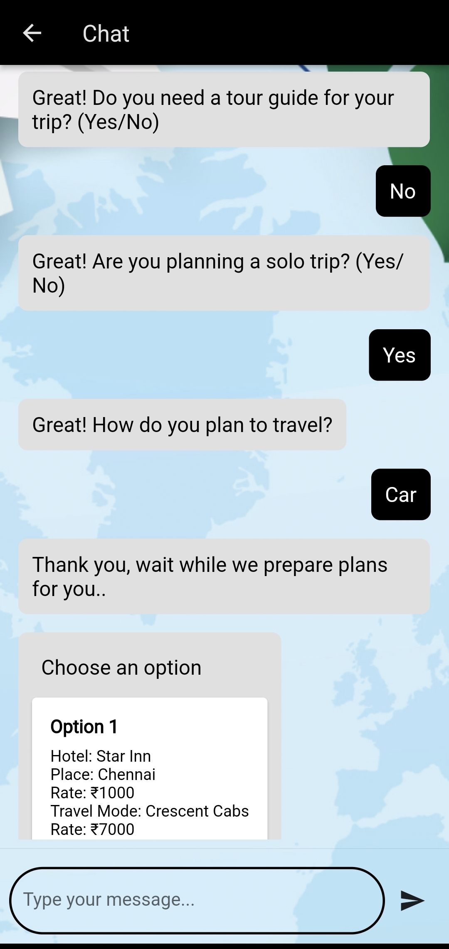

Slide 30
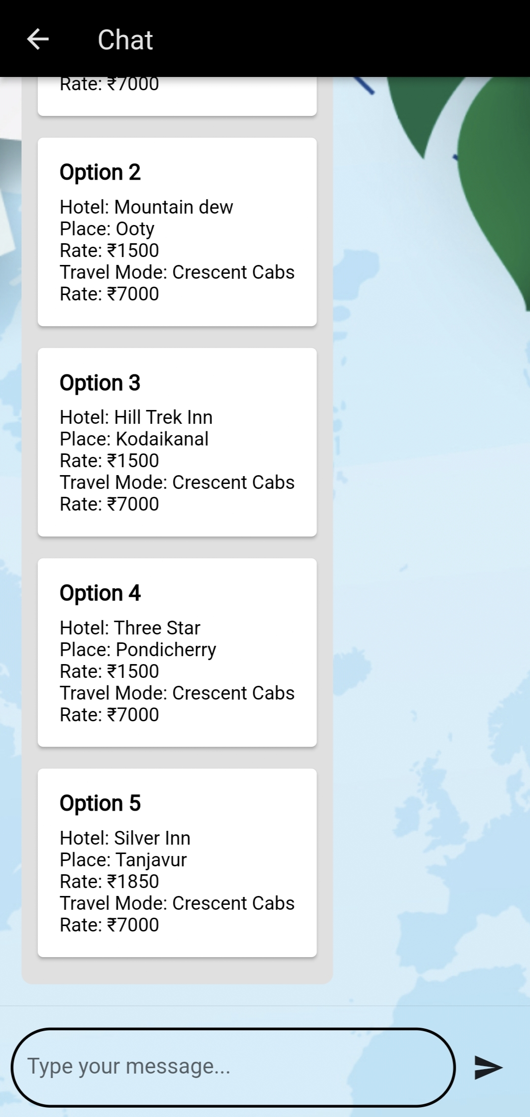

Slide 31
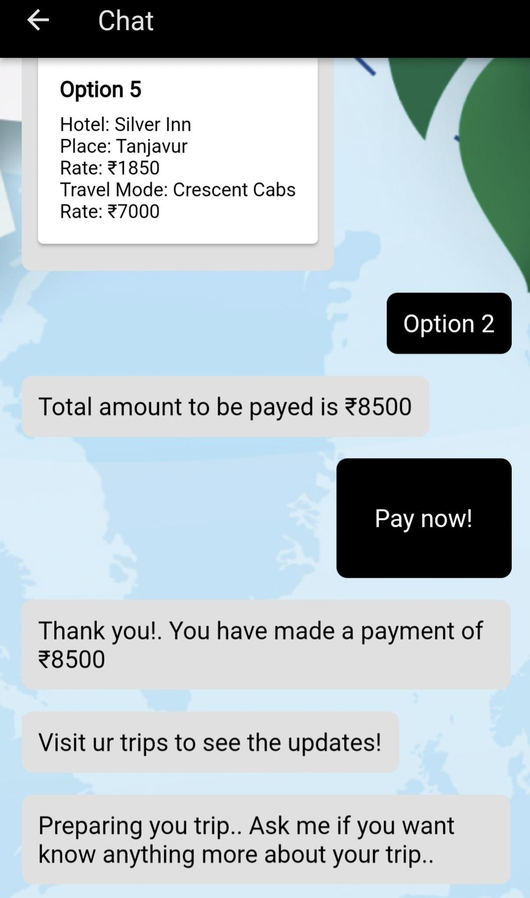

Slide 32
PUBLICATIONS
[1] Revathy A S, Amrutha Anil, Anandhu Anil, Niveditha R Naik, Sarathkumar M B.
”An AI Assisted Virtual Travel Agent: A Literature Survey”. In:International Research
Journal Of Modernization In Engineering Technology And Science (IRJMETS)-
(Volume:05/Issue:05/May-2023.)
[2] Revathy A S, Amrutha Anil, Anandhu Anil, Niveditha R Naik, Sarathkumar M B. ”
AI TRIAD: AN AI ASSISTED TRIP ADVISOR ”. In:International Research Journal Of
Modernization In Engineering Technology And Science (IRJMETS)-
(Volume:05/Issue:05/May-2023.)

Slide 33
REFERENCE https://ijarcce.com/wp-content/uploads/2021/05/IJARCCE.2021.10509.pdf https://run.unl.pt/bitstream/10362/39709/1/Geisler_2018.pdf https://www.researchgate.net/publication/344444604_Impact_of_Artificial_Intelligence_in_Travel_Tourism_and_Hospitality https://www.researchgate.net/publication/344945162_Artificial_Intelligence_Systems_applied_to_tourism_A_Survey

Slide 34
THANK YOU

